Slide 1

Upper Confidence Bound
Presented by:
Elizer Ponio Jr.

Slide 2
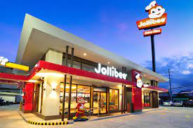
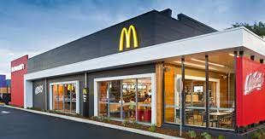

You

Slide 3
You are given 300 days and your task is to find out which restaurant has the
highest average happiness/satisfaction rating!

Slide 4
μ = 2.9
μ = 3
For example, you have visited both Jollibee on your first day and Mcdonald’s on your second day. If we used the ε-greedy approach, you would have visited mcdonald’s more because it gave you a mean happiness slightly higher than Jollibee.

Slide 5
μ = 2.9
μ = 3
If you do this strategy, you are basing your estimate mean happiness of Jollibee on one visit while you based your estimate mean happiness of Mcdonald’s on a hundred or more visits.

Slide 6
μ = 2.9 (estimate)
μ = 2.9 (estimate)
μ = 5 (true)
μ = 4 (true)
If you only estimated the mean happiness of Jollibee based on one visit, it makes much more sense to visit it more than once to find out its true mean happiness rating.

Slide 7
μ = 2.9
μ = 3
This is where the Upper Confidence Bound (UCB) strategy comes in. In UCB, it picks a restaurant that is less visited to strike a balance between exploration and exploitation.

Slide 8


$$At each time t_{1} pick restaurant r_{1} such that$$
$$\left[{\hat{\text{μ}}}_{r}\text{ +} \frac{\sqrt{2 ln{(t)}}}{N_{t} (r)} \right]$$
$$is maximized$$

Slide 9
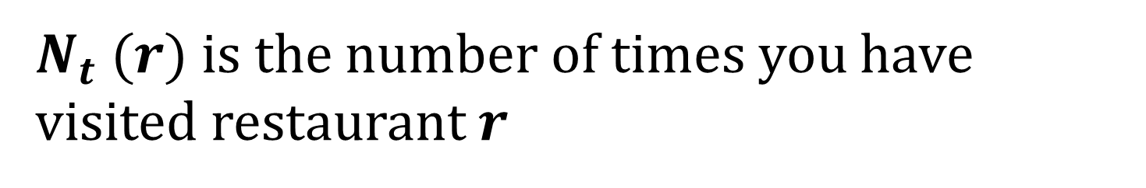
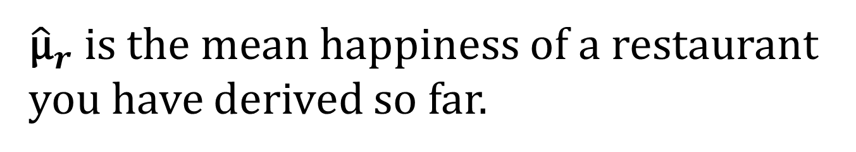
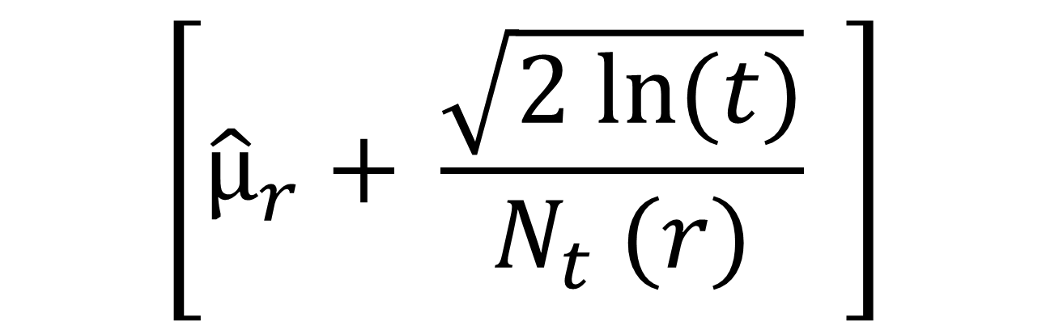
$$\left[{\hat{\text{μ}}}_{r}\text{ +} \frac{\sqrt{2 ln{(t)}}}{N_{t} (r)} \right]$$
${\hat{\text{μ}}}_{r} \text{is} \text{the} \text{mean}$happiness of a restaurant you have derived so far.
$N_{t} (r)$ is the number of times you have visited restaurant $r$

Slide 10
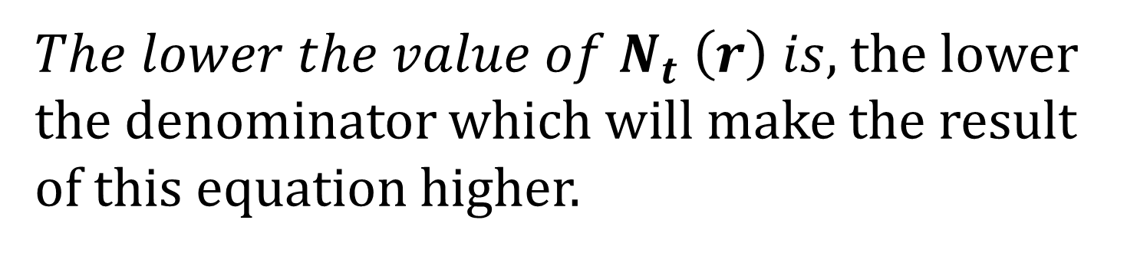
$$\left[{\hat{\text{μ}}}_{r}\text{ +} \frac{\sqrt{2 ln{(t)}}}{N_{t} (r)} \right]$$
${The lower the value of N}_{t} \left(r\right) is,$ the lower the denominator which will make the result of this equation higher.

Slide 11































Day 100
Day 102
Day 103
Day 104
Day 105
Day 106
Day 107
${\text{μ}}_{1}$ = 3.9
${\text{μ}}_{2}$ = 4
$N$= 1
$N$ = 99
${\text{μ}}_{1}$ = 4
${\text{μ}}_{2}$ = 4
$N$ = 2
$N$ = 99
${\text{μ}}_{1}$ = 4.1
${\text{μ}}_{2}$ = 4
$N$ = 3
$N$ = 99
${\text{μ}}_{1}$ = 4.3
${\text{μ}}_{2}$ = 4
$N$ = 4
$N$ = 99
${\text{μ}}_{1}$ = 4.5
${\text{μ}}_{2}$ = 4
$N$ = 5
$N$ = 99
${\text{μ}}_{1}$ = 4.8
${\text{μ}}_{2}$ = 4
$N$ = 6
$N$ = 99
${\text{μ}}_{1}$ = 5
${\text{μ}}_{2}$ = 4
μ = 3
$N$ = 7
$N$ = 99
Mean happiness at $t_{i}$
Times visited

